Slide 1

Two Day-Long Training on “DSpace” Institutional Repository
Organized by
BALID Institution of Information Management (BIIM)
1-2 May 2014
Venue: CIRDAP
  Dspace Self Archiving
Prepared By
Nur Ahammad
Junior Assistant Librarian
Independent University, Bangladesh

Slide 2
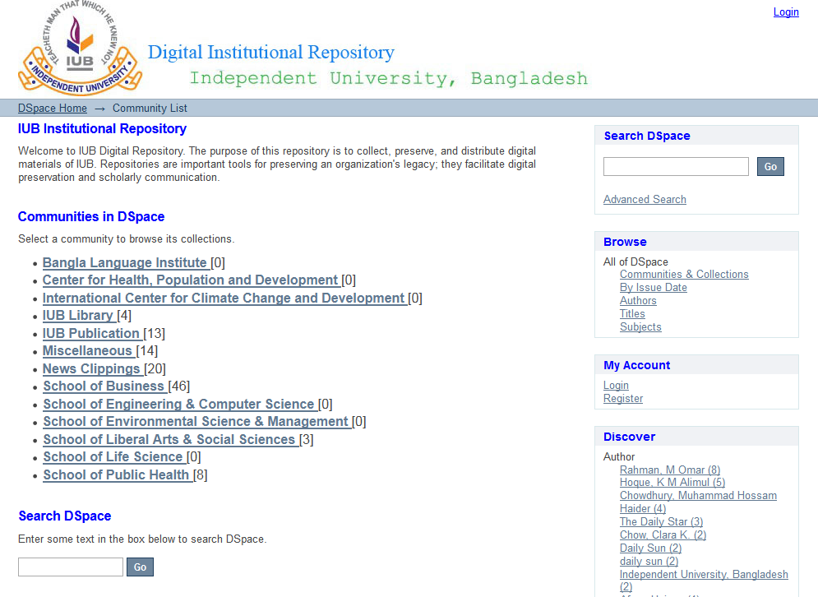
Click here

Slide 3
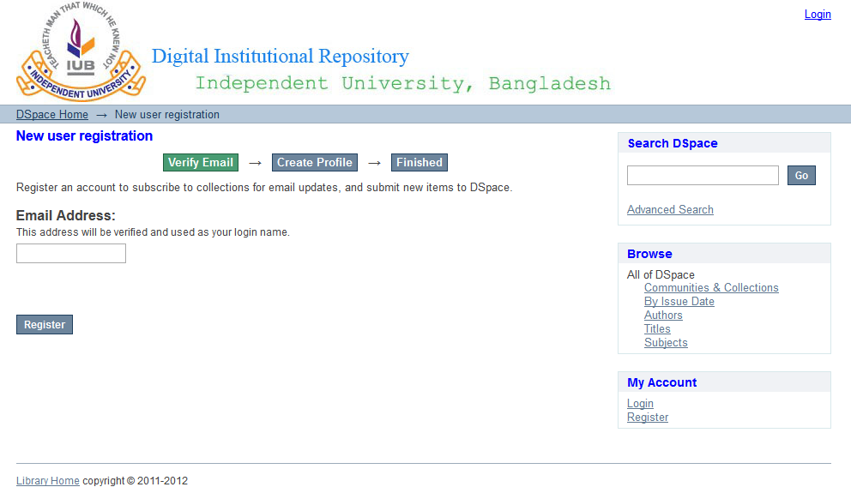
Insert your E-mail

Slide 4
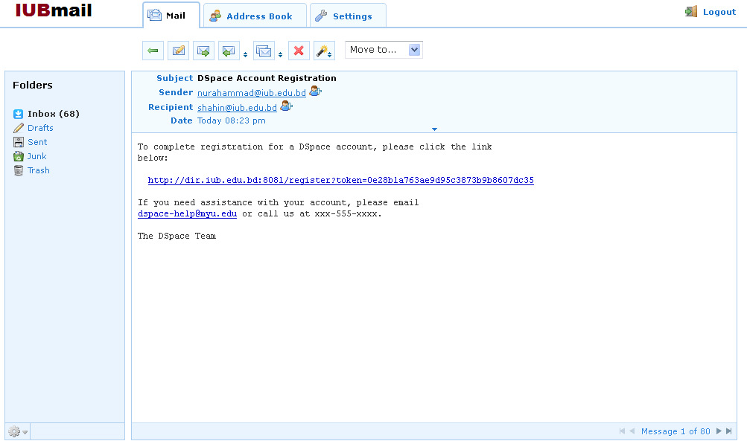
Use the link to confirm registration

Slide 5
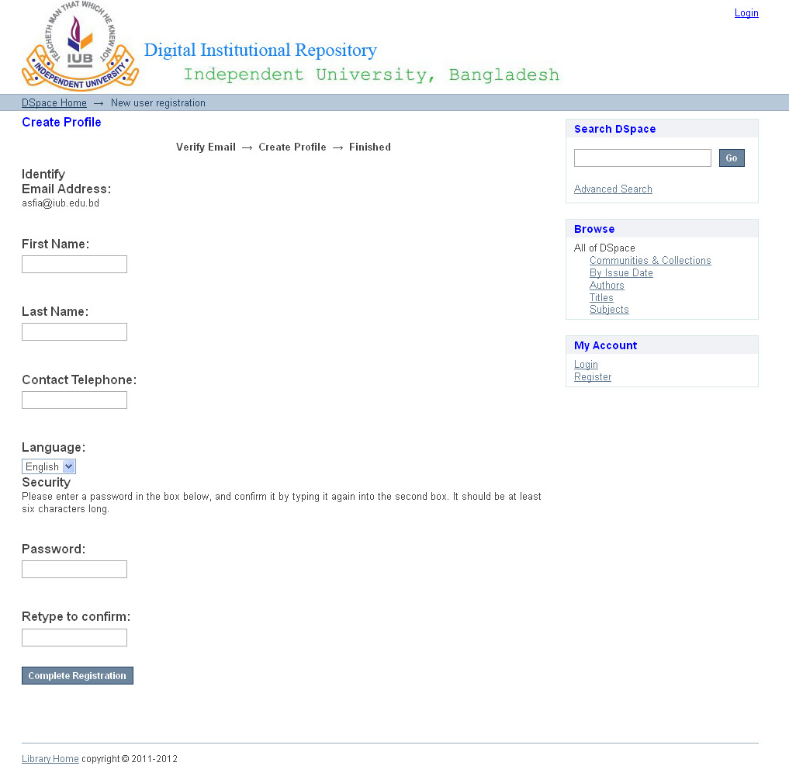
Insert your Basic information

Slide 6
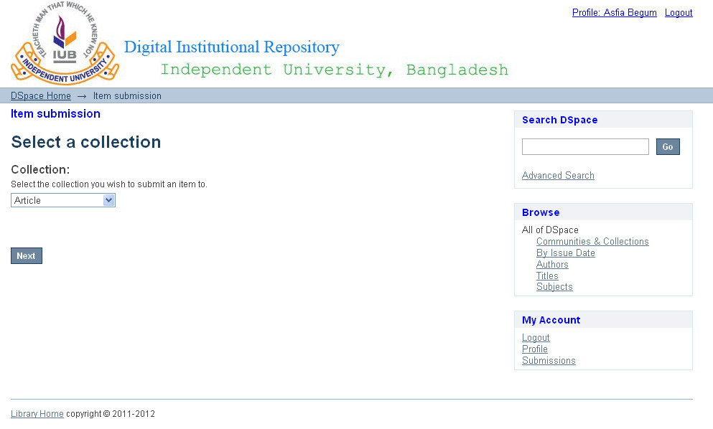
Select collection to submit your items

Slide 7
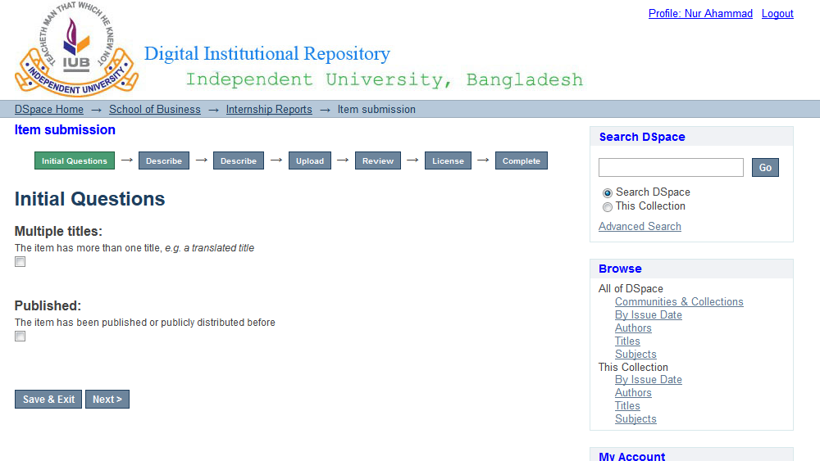

Slide 8
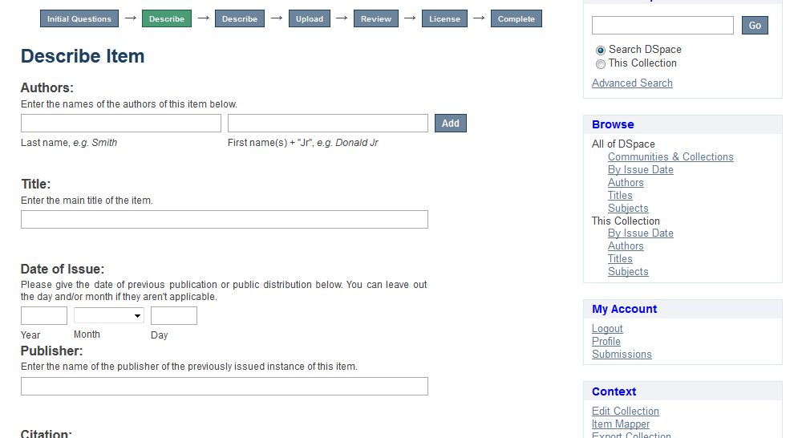
Fill these fields

Slide 9
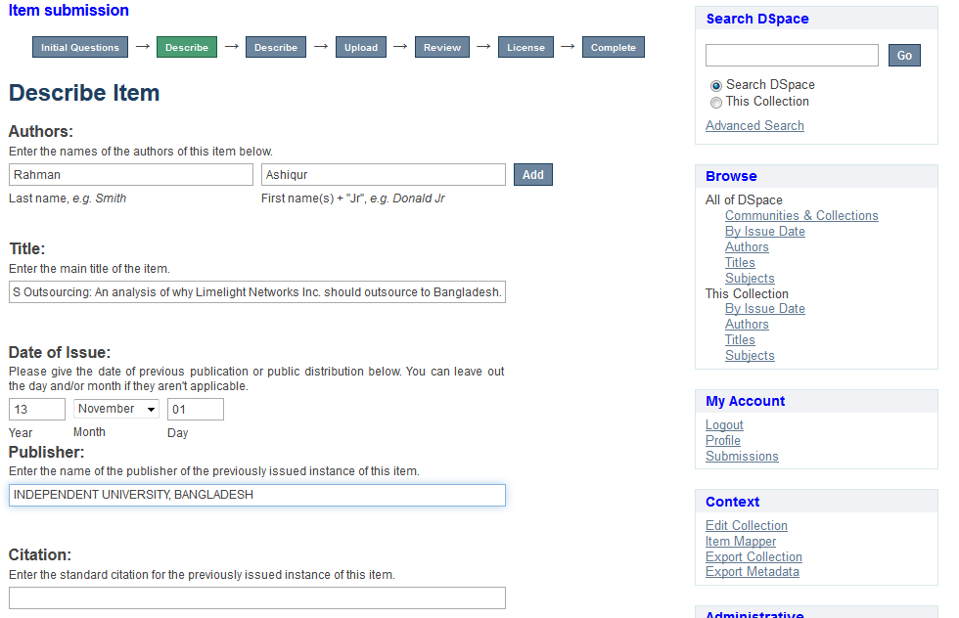

Slide 10
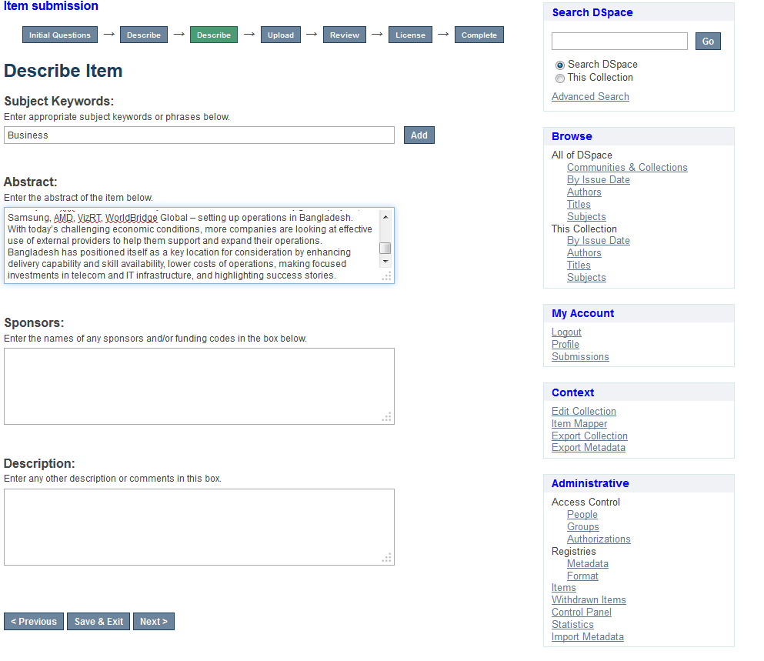
Fill these fields

Slide 11
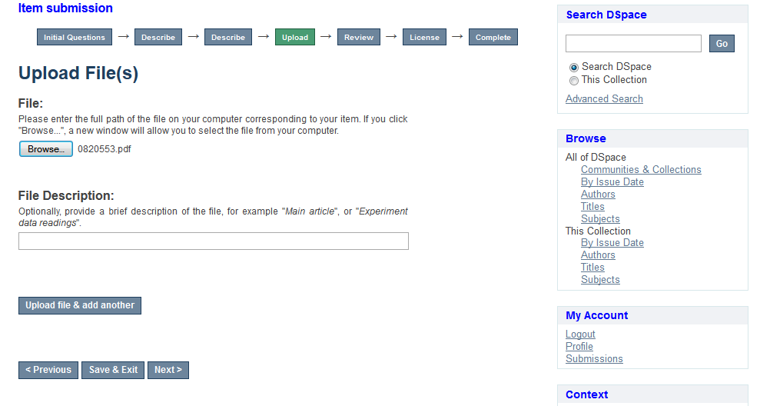
Click to select your file
Click for adding more than one file

Slide 12
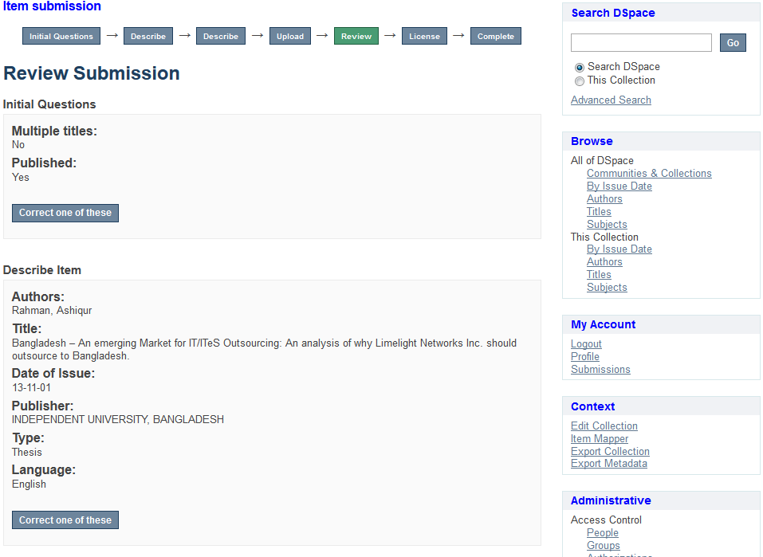

Slide 13
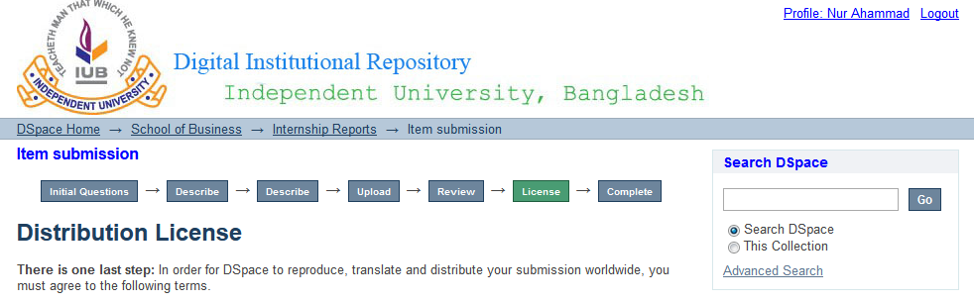
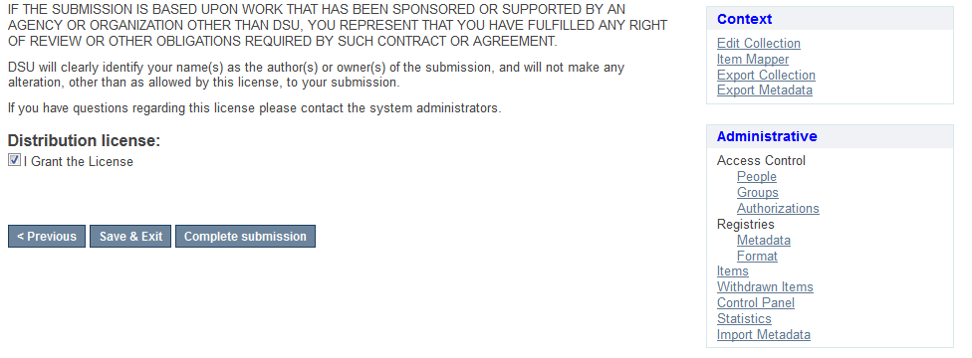

Slide 14
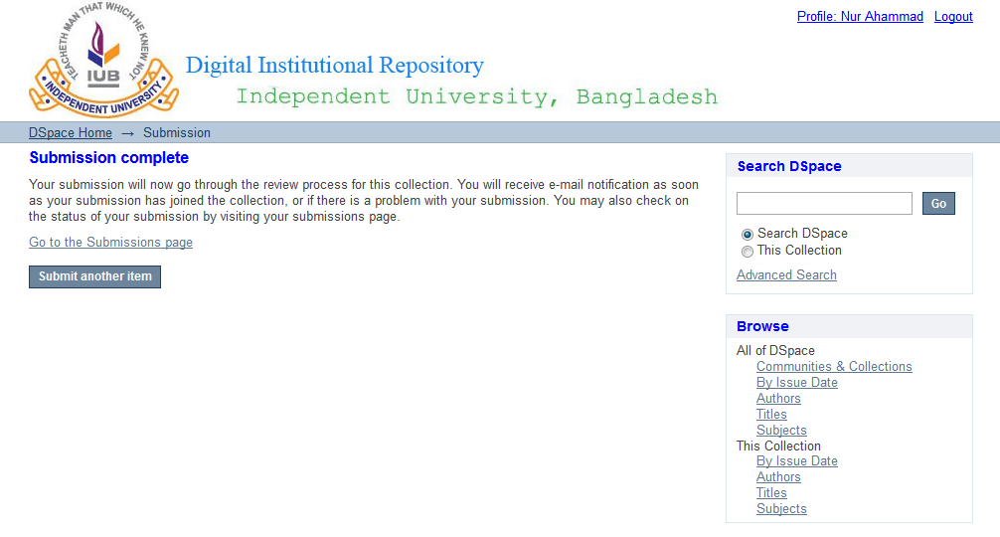

Slide 15


Slide 16


